Slide 1

Introduction to IT Project Management and Entrepreneurship
Lecture 3
Deepak Chandra Roy
Adjunct Faculty, CSE, EWU
deepak.kth@gmail.com
01685441156

Slide 2
Agenda
Previous Lecture
Project Initiation
Overview of Today's Class
Project panning
Next Class >> Project Planning in IT

Slide 3
Project Planning
After the project has been defined and the project team has been appointed, you are ready to enter the second phase in the project management life cycle.
Project planning is the heart of the project life cycle, and tells everyone involved where you're going and how you're going to get there.
The planning phase is where the project plans are documented, the project deliverables and requirements defined, and the project schedule created.
The plans created during this phase will help you to manage time, cost, quality, change, risk and related issues. It will also help you manage staff and external suppliers, to ensure that you deliver the project on time and within schedule.

Slide 4
Definition of Planning
Planning is the process of thinking systematically about the future in order to decide
what our goals are, and
how we are going to achieve them.
Planning means looking ahead, making preparations, and deciding the best course of action.

Slide 5
Why planning is necessary?
The increasing importance of timely completion.
The continuous complexity and growth in the size of the project generates the necessity for specialization. Specialization may lead to a breakdown of communications. Time planning must be found to facilitate communications.
Planning is essential for resource management.
Planning is important for the efficient and maximum utilization of resources.

Slide 6
Why planning is necessary?
Planning is basis for evaluating progress, controlling the work and making decisions.
For achieving an increase in production.
Financiers require a workable plan.
Essential in projects when their is transfer of personnel.
Minimum risk of the problems occurring.

Slide 7
Purpose of Project Planning
The purpose of the project planning phase is:
Establish business requirements.
Establish cost, schedule, list of deliverables and delivery dates.
Establish resource plan.
Get management approval and proceed to the next phase.

Slide 8
Project Planning Process
The basic processes of the project planning are
Scope planning specifies the in-scope requirements for the project and facilitates creating the work breakdown structure.
Preparing the work breakdown structure specifies the breakdown of the project into tasks and sub tasks.
Project schedule development specifies the entire schedule of the activities detailing their sequence of execution.
Resource planning specifies who will do what work at which time of the project and if any special skills are needed to accomplish the project tasks.
Budget planning specifies the budgeted cost to be incurred in the completion of the project.
Procurement planning focuses on dealing with vendors outside of your company
Risk management planning charts the risks, contingency plan and mitigation strategies.
Quality planning for quality assurance to be applied to the project.
Communication planning on the communication strategy with all project stakeholders.

Slide 9
Scope planning
You always want to know exactly what work has to be done to finish your project BEFORE you start it. You've got a collection of team members, and you need to know exactly what they're going to do to build your product or meet the project's objectives.
The scope planning process is the very first thing you do to manage your scope. Project scope planning is concerned with defining all of the work of the project and only the work needed to successfully meet the project objectives.
The whole idea here is that when you start the project, you need to have a clear picture of all the work that needs to happen on your project, and as the project progresses, you need to keep that scope up to date and written down in the project's scope management plan.

Slide 10
Scope planning cont..
One of the project manager's primary functions is to accurately document the deliverables and requirements of the project and then manage the project so that they are produced according to the agreed upon criteria.
Deliverables describe the components of the goals and objectives in a quantifiable way.
Requirements are the specifications of the deliverables

Slide 11
Project requirements
Requirements answer the following questions regarding the AS IS and TO BE states of the business: who, what, where, when, how much, how does a business process work.
Requirements specify what the project deliverable should look like and what it should do. They can be divided into six basic categories
Functional requirements
Non-functional requirements
Technical requirements
User requirements
Business requirements
Regulatory requirements

Slide 12
Project requirements cont..
Functional requirements: Functional requirements describe the characteristics of the deliverable, what emerges from the project in ordinary non-technical language. They should be understandable to the customers, and the customers should play a direct role in their development.
Functional requirements are what you want the deliverable to do.
Example If you were buying vehicles for a business your functional requirement might be; the vehicle should be able to take a load from a warehouse to a shop.
The important point to note is that WHAT is wanted is specified, and not HOW it will be delivered.

Slide 13
Project requirements cont..
Non-functional requirements: Non-functional requirements specify criteria that can be used to judge the product or service that your project delivers. They are restrictions or constraints to be placed on the deliverable and how to build it
Example: without any constraints, the functional requirement of a vehicle to take a load from a warehouse to a shop, the solutions being offered might result in anything from a large truck to a sports car! Non-functional requirements can be split into two types: performance and development. To restrict the types of solutions you might include these performance constraints:
It must take a load of at least one ton.
The load area must be covered.
The load area must have a height of at least 10 feet.

Slide 14
Project requirements cont..
Technical requirements:
Technical requirements emerge from the functional requirements, they answer the question, and how will the problem be solved this time; will it be solved technologically and/or procedurally.
They answer how the system needs to be designed and implemented to provide required functionality and fulfil required operational characteristics.
For example, in a software project, the functional requirements may stipulate that a database system will be developed to allow access to financial data through a remote terminal; the corresponding technical requirements would spell out the architecture of the data structure, the language in which the database management system will be written, the hardware on which the system will run, telecommunication protocols that should be used and so forth.

Slide 15
Project requirements cont..
User requirements: User requirements are what the users need to do with the system or product. They focus on the experience users need to have with the system, they can also reflect how the product will be designed, and define how test cases must be formulated.
Business requirements: Business requirements are the needs of the sponsoring organization, always from a management perspective. Business requirements are statements of the business rationale for the project. They are usually expressed in broad outcomes the business requires, rather than specific functions the system may perform. These requirements grow out of the vision for the product that, in turn, is driven by mission (or business) goals and objectives.
Regulatory requirements: Regulatory requirements can be internal or external and are usually non-negotiable. They are the restrictions, licenses and laws applicable to a product or business, imposed by the government

Slide 16
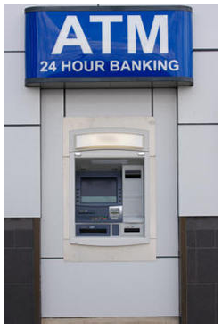
Project requirements cont..
ATM functional requirement: The system shall provide users with the ability to select whether or not to produce a hardcopy transaction receipt before completing a transaction.
ATM non-functional requirement: All displays shall be in white 14 pt Arial text on black back ground.
ATM user requirement: The system shall complete a standard withdrawal from a personal account, from login to cash, in less than two minutes for a first time user.
ATM business requirement: By providing superior service to our retail customers, Monumental Bank's ATM network will allow us to increase associated service fee revenue by 10% annually on an ongoing basis, using a baseline of December 2008.
ATM regulatory requirement: All ATMs shall connect to standard utility power sources within their civic jurisdiction, and be supplied with uninterruptible power source approved by said company
Example

Slide 17
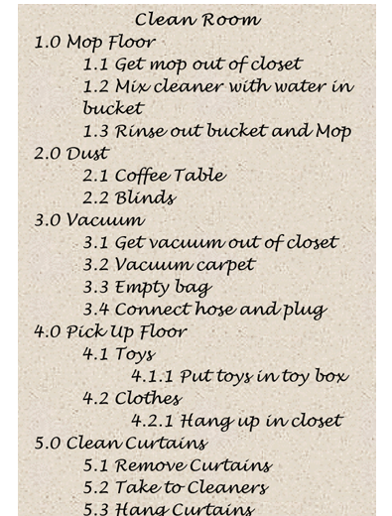
Preparing the work breakdown structure

Slide 18
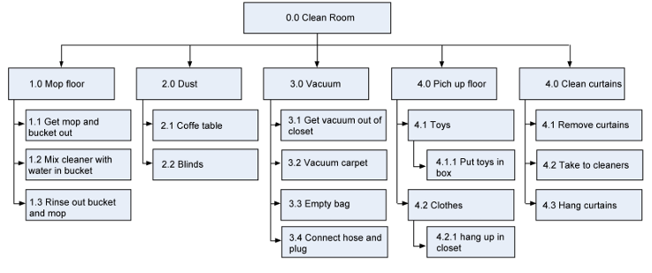
Preparing the work breakdown structure

Slide 19
Important Tools
Network Diagrams
CPM (Critical Path method)
PERT (Program Evaluation and Review Techniques)

Slide 20
Network diagram
Network:
A network consist of a set of points and set of lines connecting different pairs of points.
Events:
Events are commonly represented by circles in network diagrams.
Activity:
The arrows are called activity.
Starting Event
Completion Event
Activity

Slide 21
Event
The point in time when an activity starts or finishes, start and finish events are added.
An event (= node = connector) unlike an activity, does not consume time or resources, it merely represents a point in time at which something happen.
Numbers are given to the events to provide a unique identity to each activity.
The first event in a project schedule is the start of the project.
The last event in a project schedule is the end of the project.

Slide 22
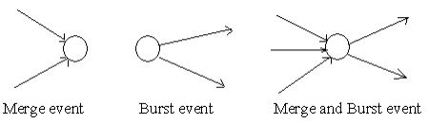
Event Types
An event represents a point in time signifying the completion of some activities and the beginning of new ones. This is usually represented by a circle in a network which is also called a node or connector.
The events are classified in to three categories
Merge event – When more than one activity comes and joins an event such an event is known as merge event.
Burst event – When more than one activity leaves an event such an event is known as burst event.
Merge and Burst event – An activity may be merge and burst event at the same time as with respect to some activities it can be a merge event and with respect to some other activities it may be a burst event

Slide 23
Activity
Each time-consuming activity (task) is portrayed by an arrow.
The tail and head of the arrow denote the start and finish of the activity whilst its duration is shown in brackets below.
The length of the arrow has no significance neither has its orientation.
Order and deliver the new machine
Activity
] Duration]
] 30]

Slide 24
Activity Identification
Start Event
Finish Event
10
Activity
20
[Duration]
Activity identification numbers
called event numbers

Slide 25
i-j Numbers of Events
i
j
Activity
Duration
The node at the tail (start) of an arrow is the i-node.
The node at the head (end) of an arrow is the j-node

Slide 26
Rules of Making Arrow Diagram
The network (the graphical representation of a project plan) must have definite points of beginning and finish.
(The accuracy and usefulness of a network is dependent mainly upon intimate knowledge of the project itself, and upon the general qualities of judgment and skill of the planning personnel.)
The arrows originate at the right side of a node and terminate at the left side of a node.
Any two events may be directly connected by no more than one activity.
Use symbols to indicate crossovers to avoid misunderstanding.
10
A
20
B
30

Slide 27
Types of activity
Predecessor Activity:
An activity which must be completed before one or more other activities start is known as predecessor activity.
Successor Activity:
An activity which started immediately after one or more of other activity are completed is known as successor activity.
Serial Activity:
Serial activities are those in which one activity must be completed before the next can start. They are linked in a sequence, and there is a clear dependency between them.
Concurrent Activity:
Activities which can be accomplished concurrently are known as concurrent activities. It may be noted that an activity can be a predecessor or a successor to an event or it may be concurrent with one or more of other activities.
Dummy Activity:
An activity which does not consume any kind of resource but merely depicts the technological dependence is called a dummy activity

Slide 28
Logical Relationships
10
A
20
B
30
Node “20” is the j-node for activity “A” and it is also the i-node for activity “B” then activity “A” is a predecessor to activity “B”.
In other words activity “B” is a successor to activity “A”.
Activity B depends on activity A.

Slide 29
Logical Relationships
Succeeding activities
30
10
20
40
50
Event numbers must not be duplicated in a network.
j-node number greater than i-node number.

Slide 30
Logical Relationships
Concurrent activities are those that can be performed simultaneously or in parallel. There is no strict dependency between these activities, and they can occur concurrently, saving time and potentially reducing the project's duration.
In a PERT diagram, concurrent activities are represented as separate branches or paths that do not have direct dependencies on each other.
For example, in a construction project, activities like site preparation, electrical wiring installation, and plumbing installation can often occur concurrently since they don't depend on each other. These activities can save time and speed up the project.
Concurrent activities
80
180
120
170
190
160

Slide 31
Logical Relationships
The network must be a logical representation of all the activities. Where necessary, "dummy activities" are used for:
Unique numbering and
Logical sequencing.
Dummy activity is an arrow that represents merely a dependency of one activity upon another. A dummy activity carries a zero time. It is also called dependency arrow.
The dummy activity is inserted in the network to clarify the activity pattern in the following two situations
To make activities with common starting and finishing points distinguishable
To identify and maintain the proper precedence relationship between activities that is not connected by events.

Slide 32
Dummy Activities
The following network shows incorrect activity numbering.
90
A
50
70
80
100
B
60
110
Activity A and B have the same starting and ending points. It violates the
rules of network diagram. In a project network diagram, two different activities
cannot have the same starting event and ending event. Each activity must have a unique
pair of start and end events or nodes.
Notes:
Having unique start and end events for each activity ensures that there is no confusion regarding which activity is being referred to. It helps project managers, team members, and stakeholders to clearly identify, track, and manage each activity in the project. If multiple activities shared the same start and end events, it would be challenging to differentiate between them.

Slide 33
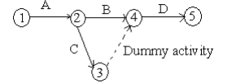
Dummy Activities
For unique numbering, use dummies.
75
90
A
50
70
80
100
B
60
110
Consider a situation where A and B are serial activities. C is dependent on A and D is dependent on A and B both. Such a situation can be handled by using a dummy activity as shown in the figure.

Slide 34
Rules of Making Arrow Diagram
There must be no "looping" in the network. The loop is an indication of faulty logic. The definition of one or more of the dependency relationships is not valid.
90
100
120
130
110

Slide 35
Rules of Making Arrow Diagram
The network must be continuous (without unconnected activities).
30
60
100
10
20
50
90
120
40
70
110
80

Slide 36
Rules of Making Arrow Diagram
Networks should have only one initial event and only one terminal event.
30
60
10
20
50
90
120
40
70
110

Slide 37
Common errors in drawing networks
The three types of errors are most commonly observed in drawing network diagrams
Dangling
Looping or Cycling
Redundancy

Slide 38
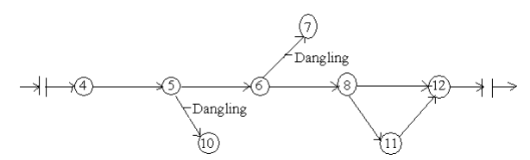
Dangling
To disconnect an activity before the completion of all activities in a network diagram is known as dangling. As shown in the figure activities (5 – 10) and (6 – 7) are not the last activities in the network. So the diagram is wrong and indicates the error of dangling

Slide 39
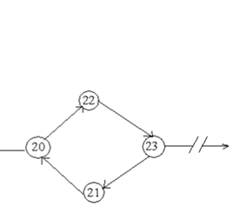
Looping or Cycling
Looping error is also known as cycling error in a network diagram. Drawing an endless loop in a network is known as error of looping as shown in the following figure

Slide 40
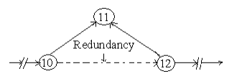
Redundancy
Unnecessarily inserting the dummy activity in network logic is known as the error of redundancy as shown in the following diagram

Slide 41
Example of network diagram formation
Draw a network diagram to express the following relationship.
Activity | Immediate Predecessor
A | -
B | -
C | A
D | A,B
C
2
4
A
D
1
3
B

Slide 42
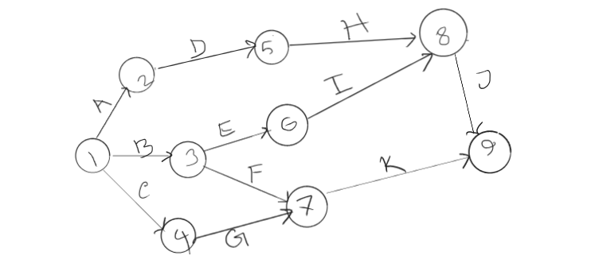
Example of network diagram formation
Draw a network diagram to express the following relationship.
Activity | A | B | C | D | E | F | G | H | I | J | k
Predecessor | - | - | - | A | B | B | C | D | E | H,I | F,G

Slide 43
Example of network diagram formation
Draw a network diagram to express the following relationship.
Activity | A | B | C | D | E | F | G | H | I | J | k
Predecessor | - | - | A | A | I,J,K | B,D | B,D | F | A | G,H | F

Slide 44
Network Analysis (Computation)
Occurrence times of Events = Early and late timings of event occurrence = Early and late event times
Earliest
Event
Time
Activity
Activity
Event
Label
Latest
Event
Time
Head
Tail
Standard layout for recording data

Slide 45
Early Event Time (EET = E =T_{E})
Early Event Time (Earliest occurrence time for event) is the earliest time at which an event can occur, considering the duration of precedent activities.
Forward Pass for Computing EET
Each activity starts as soon as possible, i.e., as soon as all of its predecessor activities are completed.
Direction: Left to right, from the beginning to the end of the project
Set: EET of the initial node = 0
Add: EET_{j} = EET_{i} + D_{ij}
Take the maximum
The estimated project duration = EET of the last node.
EET_{i}
Activity
EET_{j}
i
j
D_{ij}

Slide 46
Early Event Times (EET = E =T_{E})
0
3
4
12
10
20
30
40
A
B
C
3
1
8

Slide 47
Early Event Times (T_{E})
4
K
40
4
15
L
24
70
80
9
50
12
M
5

Slide 48
Early Event Times (T_{E})
20
50
3
2
3
4
10
30
70
4
5
7
60
3
40
1

Slide 49
Early Event Times (T_{E})
20
2
8
50
3
2
3
4
10
4
0
30
16
70
4
5
9
7
60
3
40
3
1

Slide 50
Late Event Time (LET = L =T_{L})
Late Event Time (Latest occurrence time of event) is the latest time at which an event can occur, if the project is to be completed on schedule.
Backward Pass for Computing LET
Direction: Right to left, from the end to the beginning of the project
Set: LET of the last (terminal) node = EET for it
Subtract: LET_{i} = LET_{j} - D_{ij}
Take the minimum
EET_{i}
Activity
EET_{j}
i
j
LET_{i}
D_{ij}
LET_{j}

Slide 51
Late Event Times (T_{L})
8
13
50
3
16
16
9
9
60
40
7

Slide 52
Late Event Times (T_{L})
2
20
50
8
3
2
3
4
10
4
0
30
16
70
4
5
60
9
7
3
3
1
40

Slide 53
Late Event Times (T_{L})
2
20
50
8
10
3
13
2
3
4
10
4
0
30
16
70
0
4
4
16
5
60
9
7
3
40
9
3
1
8

Slide 54
Network Analysis (Computation)
Activity Times (Schedule)
Early Start (ES): The earliest time at which an activity can be started.
ES_{ij} = EET_{i}
Early Finish (EF): The earliest time at which an activity can be completed.
EF_{ij} = ES_{ij} + D_{ij}
Late Finish (LF): The latest time at which an activity can be completed without delaying project completion.
LF_{ij} = LET_{j}
Late Start (LS): The latest time at which an activity can be started.
LS_{ij} = LF_{ij} − D_{ij}

Slide 55
Example: Activity Times
2
20
50
8
10
3
13
2
3
4
10
4
0
30
16
70
0
4
4
16
5
60
9
7
3
40
9
3
1
ES₂₀₋₅₀ = EET₂₀ = 2
EF₂₀₋₅₀ = ES + D = 2 + 3 = 5
LF₂₀₋₅₀ = LET₅₀ = 13
LS₂₀₋₅₀ = LF – D = 13 – 3 = 10
8

Slide 56
PERT
Activity | Predecessors | Durations (in Weeks)
 |  | O | M | P
A | - | 5 | 6 | 7
B | - | 1 | 3 | 5
C | - | 1 | 4 | 7
D | A | 1 | 2 | 3
E | B | 1 | 2 | 9
F | C | 1 | 5 | 9
G | C | 2 | 2 | 8
H | E,F | 4 | 4 | 10
I | D | 2 | 5 | 8
J | H,G | 2 | 2 | 8
O – Optimistic Time
M – Most Likely Time
P – Pessimistic

Slide 57
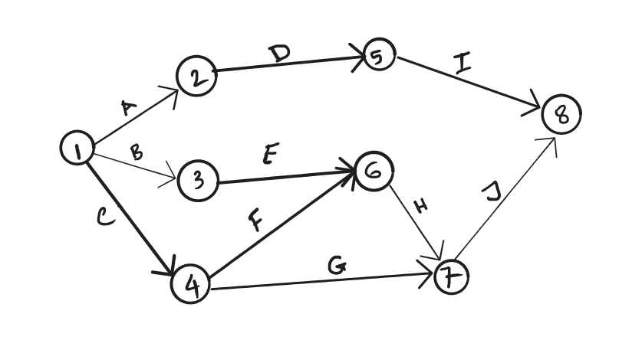
PERT Cont..

Slide 58
PERT Cont..
Activity | Predecessors | Durations (in Weeks) |  |  | Mean Duration | Variance
 |  | O | M | P
A | - | 5 | 6 | 7
B | - | 1 | 3 | 5
C | - | 1 | 4 | 7
D | A | 1 | 2 | 3
E | B | 1 | 2 | 9
F | C | 1 | 5 | 9
G | C | 2 | 2 | 8
H | E,F | 4 | 4 | 10
I | D | 2 | 5 | 8
J | H,G | 2 | 2 | 8

Slide 59
PERT Cont..
Mean Duration
te = Expected Time
tm = Most Likely Time
to = Optimistic Time
tp = Pessimistic Time
te = (to + 4tm + tp)/6

Slide 60
PERT Cont..
Variance
σ²=[(t_{p}-t_{o})/6 ]²
σ = Sigma
^{Variance} = Square root of standard deviation

Slide 61
PERT Cont..
Activity | Predecessors | Durations (in Weeks) |  |  | Mean Duration | Variance
 |  | O | M | P
A | - | 5 | 6 | 7 | 6
B | - | 1 | 3 | 5 | 3
C | - | 1 | 4 | 7 | 4
D | A | 1 | 2 | 3 | 2
E | B | 1 | 2 | 9 | 3
F | C | 1 | 5 | 9 | 5
G | C | 2 | 2 | 8 | 3
H | E,F | 4 | 4 | 10 | 5
I | D | 2 | 5 | 8 | 5
J | H,G | 2 | 2 | 8 | 3

Slide 62
PERT Cont..
Activity | Predecessors | Durations (in Weeks) |  |  | Mean Duration | Variance
 |  | O | M | P
A | - | 5 | 6 | 7 | 6 | 0.11
B | - | 1 | 3 | 5 | 3 | 0.44
C | - | 1 | 4 | 7 | 4 | 1.00
D | A | 1 | 2 | 3 | 2 | 0.11
E | B | 1 | 2 | 9 | 3 | 1.78
F | C | 1 | 5 | 9 | 5 | 1.78
G | C | 2 | 2 | 8 | 3 | 1.00
H | E,F | 4 | 4 | 10 | 5 | 1.00
I | D | 2 | 5 | 8 | 5 | 1.00
J | H,G | 2 | 2 | 8 | 3 | 1.00

Slide 63
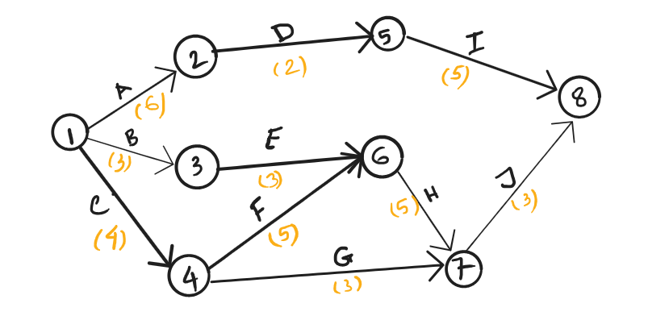
PERT Cont..
Assign duration with Mean Duration time.

Slide 64
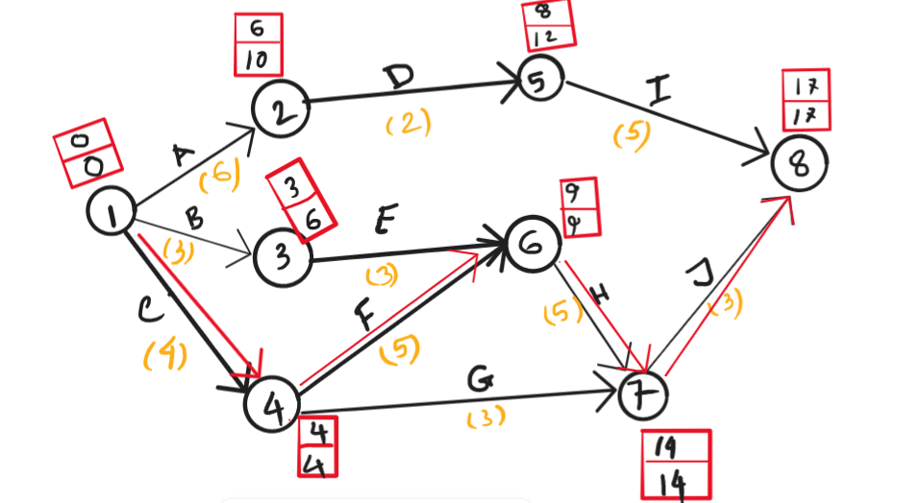
PERT Cont..
Critical Path: C-F-H-J
Expected Time, t_{e} = 4+5+5+3 = 17 Weeks

Slide 65
PERT Cont..
Activity | Mean Duration | Variance
C | 4 | 1.00
F | 5 | 1.78
H | 5 | 1.00
J | 3 | 1.00
Total | 17 | 4.78
Standard Deviation, σ = √ (∑ variance) = √ 4.78 = 2.19 weeks
What is the probability of completing the project on or before 22 weeks?
P (x ≤ 22) = P [ (x-µ)/ σ ≤ (22 - 17)/2.19 ]
= P [z ≤ 2.28]

Slide 66
PERT Cont..
The standard normal distribution formula is below:
Z – Score = ( X – µ ) / σ
Where,
X is a normal random variable
µ is the average or the mean
σ is the standard deviation
P (x ≤ 22) = P [ (x-µ)/ σ ≤ (22 - 17)/2.19 ]
= P [z ≤ 2.28]
2.28 = 2.2+0.08

Slide 67
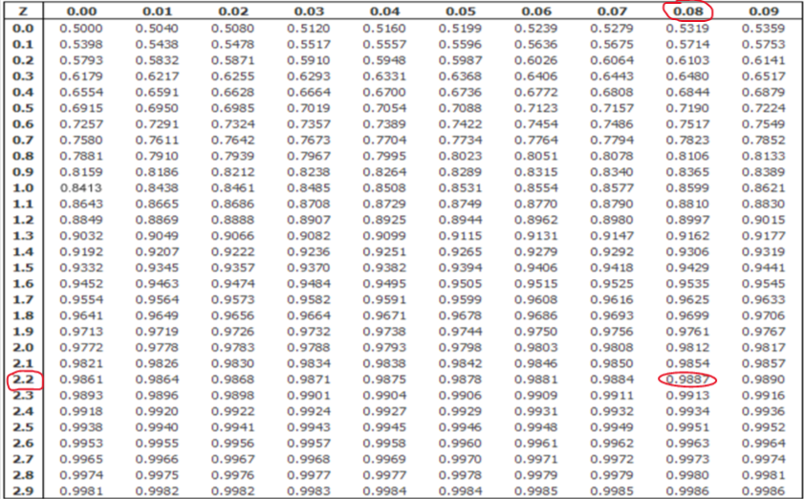
Standard Normal Distribution Table
Standard normal distribution, Z –score = 2.28 = 2.2+0.08
Notes:
https://www.wallstreetmojo.com/standard-normal-distribution-formula/

Slide 68
Network Analysis (Computation)
Activity Floats
Total Float (TF)
Total float or path float is the amount of time that an activity’s completion may be delayed without extending project completion time.
Total float or path float is the amount of time that an activity’s completion may be delayed without affecting the earliest start of any activity on the network critical path.

Slide 69
Network Analysis (Computation)
Activity Floats
Total Float (TF)
Total path float time for activity (i-j) is the total float associated with a path.
For arbitrary activity (i−j), the total float can be written as:
Path Float =Total Float (TF_{ij})
= LS_{ij} − ES_{ij}
= LF_{ij} − EF_{ij}
= LET_{j} – EET_{i} − D_{ij}

Slide 70
Example: Total Float Times
2
20
50
8
10
3
13
2
3
4
10
4
0
30
16
70
0
4
4
16
5
60
9
7
3
40
9
TF₂₀₋₅₀ = LS₂₀₋₅₀ - ES₂₀₋₅₀
TF₂₀₋₅₀ = 10 – 2 = 8
TF₂₀₋₅₀ = LF₂₀₋₅₀ - EF₂₀₋₅₀
TF₂₀₋₅₀ = 13 – 5 = 8
TF₂₀₋₅₀ = LET₅₀ – EET₂₀ - D₂₀₋₅₀
TF₂₀₋₅₀ = 13 – 2 - 3 = 8
3
1
8

Slide 71
Network Analysis (Computation)
Activity Floats
Free Float (FF)
Free float or activity float is the amount of time that an activity’s completion time may be delayed without affecting the earliest start of succeeding activity.
Activity float is “owned” by an individual activity, whereas path or total float is shared by all activities along a slack path.
Total float equals or exceeds free float (TF ≥ FF).
For arbitrary activity (i−j), the free float can be written as:
Activity Float = Free Float (FF_{ij})
= ES_{jk} − EF_{ij}
= EET_{j} – EET_{i} − D_{ij}

Slide 72
Example: Free Float Times
2
20
50
8
10
3
13
2
3
4
10
4
0
30
16
70
0
4
4
16
5
60
9
7
3
40
9
3
1
FF₂₀₋₅₀ = ES₅₀₋₇₀ - EF₂₀₋₅₀
FF₂₀₋₅₀ = 8 – 5 = 3
FF₂₀₋₅₀ = EET₅₀ – EET₂₀ - D₂₀₋₅₀
FF₂₀₋₅₀ = 8 – 2 - 3 = 3
8

Slide 73
Network Analysis (Computation)
Activity Floats
Interfering Float (ITF)
Interfering float is the difference between TF and FF.
If ITF of an activity is used, the start of some succeeding activities will be delayed beyond its ES.
In other words, if the activity uses its ITF, it “interferes” by this amount with the early times for the down path activity.
For arbitrary activity (i−j), the Interfering float can be written as:
Interfering Float (ITF_{ij})
= TF_{ij} − FF_{ij}
= LET_{j} − EET_{j}

Slide 74
Example: Interfering Float Times
2
20
50
8
10
3
13
2
3
4
10
4
0
30
16
70
0
4
4
16
5
60
9
7
3
40
9
3
1
ITF₂₀₋₅₀ = TF₂₀₋₅₀ - FF₂₀₋₅₀
IFF₂₀₋₅₀ = 8 – 3 = 5
ITF₂₀₋₅₀ = LET₅₀ – EET₅₀
ITF₂₀₋₅₀ = 13 – 8 = 5
8

Slide 75
Network Analysis (Computation)
Activity Floats
Independent Float (IDF)
It is the amount of float which an activity will always possess no matter how early or late it or its predecessors and successors are.
The activity has this float “independent” of any slippage of predecessors and any allowable start time of successors. Assuming all predecessors end as late as possible and successors start as early as possible.
IDF is “owned” by one activity.
In all cases, independent float is always less than or equal to free float (IDF ≤ FF).

Slide 76
Network Analysis (Computation)
Activity Floats
Independent Float (IDF)
For arbitrary activity (i−j), the Independent Float can be written as:
Independent Float (IDF_{ij})
= Max (0, EET_{j} − LET_{i} – D_{ij})
= Max (0, Min (ES_{jk}) - Max (LF_{hi}) − D_{ij})

Slide 77
Example: Independent Float Times
2
20
50
8
10
3
13
2
3
4
10
4
0
30
16
70
0
4
4
16
5
60
9
7
3
40
9
3
1
8
IDF₂₀₋₅₀ = Max. (0, [EET₅₀ – LET₂₀ - D₂₀₋₅₀])
IDF₂₀₋₅₀ = Max. (0, [8 – 10 – 3]) = 0

Slide 78
Network Analysis (Computation)
Critical Path
Critical path is the path with the least total float = The longest path through the network.
Subcritical Paths
Subcritical paths have varying degree of path float and hence depart from criticality by varying amounts.
Subcritical paths can be found in the following way:
Sort the activities in the network by their path float, placing those activities with a common path float in the same group.
Order the activities within a group by early start time.
Order the groups according to the magnitude of their path float, small values first.

Slide 79
Example
Draw an arrow diagram to represent the following project. Calculate occurrence times of events, activity times, and activity floats. Also determine the critical path and the degree of criticality of other float paths.
Activity | Preceding Activity | Time (days)
A | None | 5
B | A | 7
C | A | 4
D | A | 8
E | B | 6
F | D | 8
G | E, C, F | 3
H | G | 4
I | G | 6

Slide 80
Example
Activity on arrow network and occurrence times of events
30
12
70
28
15
30
B
E
[7]
[6]
H
[4]
0
A
20
50
60
80
5
C
21
G
24
I
30
10
0
[5]
5
[4]
21
[3]
24
6
30
D
F
[8]
[8]
40
13
13

Slide 81
Example
Activity times and activity floats
Activity | ES | EF | LF | LS | TF | FF | ITF | IDF
A | 0 | 5 | 5 | 0 | 0 | 0 | 0 | 0
B | 5 | 12 | 15 | 8 | 3 | 0 | 3 | 0
C | 5 | 9 | 21 | 17 | 12 | 12 | 0 | 12
D | 5 | 13 | 13 | 5 | 0 | 0 | 0 | 0
E | 12 | 18 | 21 | 15 | 3 | 3 | 0 | 0
F | 13 | 21 | 21 | 13 | 0 | 0 | 0 | 0
G | 21 | 24 | 24 | 21 | 0 | 0 | 0 | 0
H | 24 | 28 | 30 | 26 | 2 | 2 | 0 | 2
I | 24 | 30 | 30 | 24 | 0 | 0 | 0 | 0

Slide 82
Example
Critical path and subcritical paths
Activity | ES | EF | LF | LS | TF | Criticality
A | 0 | 5 | 5 | 0 | 0 | Critical Path
D | 5 | 13 | 13 | 5 | 0
F | 13 | 21 | 21 | 13 | 0
G | 21 | 24 | 24 | 21 | 0
I | 24 | 30 | 30 | 24 | 0
H | 24 | 28 | 30 | 26 | 2 | a “near critical” path
B | 5 | 12 | 15 | 8 | 3 | Third most critical path
E | 12 | 18 | 21 | 15 | 3
C | 5 | 9 | 21 | 17 | 12 | Path having most float

Slide 83
Case Study
Installation of a new machine and training the operator
Activity Code | Activity Description | Depends on | Level | Duration (day)
100 | Inspect the machine after installation | 300 | 4 | 1
200 | Hire the operator | None | 1 | 25
300 | Install the new machine | 500, 400 | 3 | 2
400 | Inspect and store the machine after delivery | 700 | 2 | 1
500 | Hire labor to install the new machine | None | 1 | 20
600 | Train the operator | 200, 300 | 4 | 3
700 | Order and deliver the new machine | None | 1 | 30

Slide 84
CPM (Critical Path Method)
In project management, the critical path is the longest sequence of tasks that must be completed to execute a project. The tasks on the critical path are called critical activities because if they’re delayed, the whole project completion will be delayed. To find the critical path, project managers use the critical path method (CPM).

Slide 85
PERT (Program Evaluation and Review Technique)
Program Evaluation Review Technique (PERT) is a project management planning tool used to calculate the amount of time it will take to realistically finish a project.
PERT charts are used to plan tasks within a project — making it easier to schedule deliverables and coordinate with team members.
PERT charts were created in the 1950s to manage the creation of weapons and defense projects for the US Navy. While PERT was being introduced in the Navy, the private sector simultaneously gave rise to a similar method called critical path.
Source: https://www.wrike.com/project-management-guide/faq/what-is-pert-in-project-management/

Slide 86
PERT (Program Evaluation and Review Technique) cont..
The term "PERT" stands for "Program Evaluation and Review Technique." PERT is a project management tool that is used to estimate the duration of activities in a project. The PERT method uses three time estimates for each activity:
Optimistic Time (O): This is the shortest time that an activity can be completed if everything goes perfectly.
Most Likely Time (M): This is the best estimate of the time an activity will take, considering normal variations and circumstances.
Pessimistic Time (P): This is the longest time an activity might take if there are unexpected delays or issues.
To calculate the mean duration (expected duration) for an activity using PERT, you can use the following formula:
Mean (Expected) Duration = (O + 4M + P) / 6
This formula gives a weighted average of the three time estimates, with more weight placed on the "Most Likely Time." It helps in generating a more realistic estimate for the activity's duration, taking into account both optimistic and pessimistic scenarios.
In the context of a larger project, you can use these mean durations for individual activities to estimate the overall project duration. PERT is especially useful for projects with a high degree of uncertainty and variability in activity durations.

Slide 87
Homework/Assignment
Draw WBS & CPM for your projects

Slide 88
Questions and Discussion

